Slide 1



X
Final Task
Data Engineer Kalbe Nutritionals x Rakamin
Presented by
Muhammad Wahfiuddin Pradiwa

Slide 2

Muhammad Wahfiuddin Pradiwa
Experience
About Me
I am a final student at Diponegoro University majoring in Economics. I really interested in data field especially data analytics. Skills that i have are SQL, Power BI, Looker Data Studio and Excel.

Slide 3
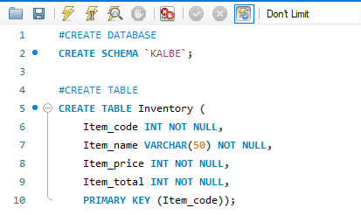
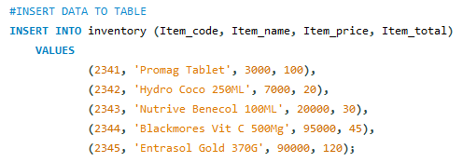
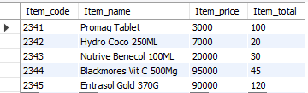
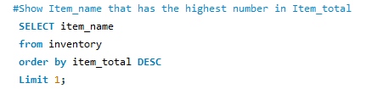

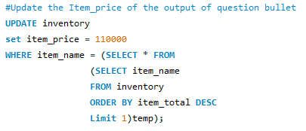
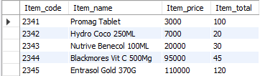

Slide 4
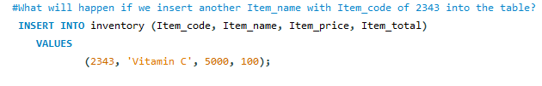
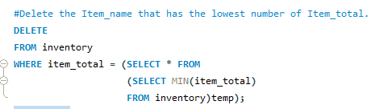


Slide 5
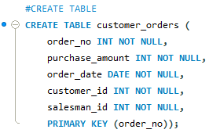
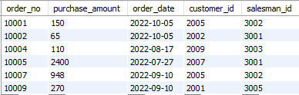
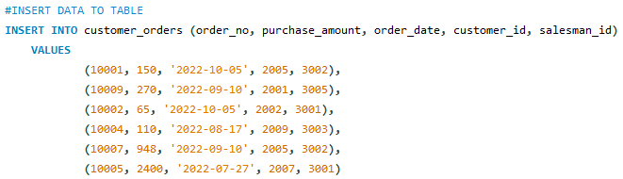
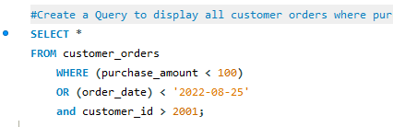


Slide 6
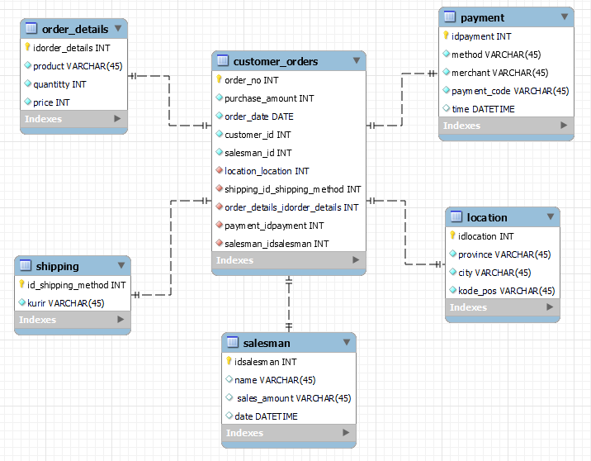

Slide 7
Github Link
https://github.com/pradiwawahfiuddin/PBI_Rakamin-x-Kalbe_Nutritionals.git
X

Slide 8
Thank You
X

